Slide 1
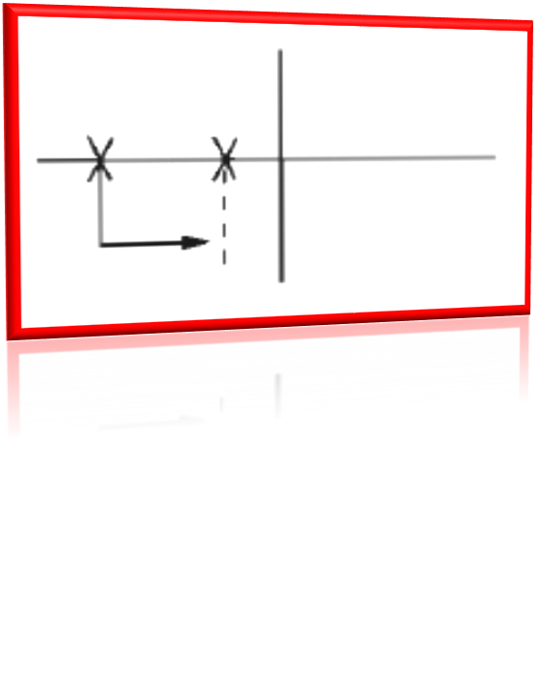

Past Perfect Progressive

Slide 2
Past perfect progressive(affirmative)
Subject + Auxiliary verb + Auxiliary verb + Verb + ing
I had been running for an hour when it started raining.
You had been waiting there for more than two hours when she finally arrived.
Kathy put on weight because she had been eating too much sugar.
Everything had been going well in my life until my world fell apart several months ago.

Slide 3
Past perfect progressive (questions)
Had you been waiting there for more than two hours when she finally arrived?

Slide 4
Past perfect progressive(negative)
Subject + Auxiliary verb + not + Auxiliary verb + Verb + ing
Examples:
If it hadn't been raining, we would have played football.
You had not been waiting there for more than two hours when she finally arrived.

Slide 5
ADVERB PLACEMENT
The examples below show the placement for grammar adverbs such as: always, only, never, ever, still, just, etc.
Examples:
You had only been waiting there for a few minutes when she arrived.
Had you only been waiting there for a few minutes when she arrived?

Slide 6

Study this example situation:
Yesterday morning I got up and looked out of the window. The sun was shining but the ground was very wet.
It had been raining.
It was not raining when I looked out of the window; the sun was shining. But it had been raining before. That's why the ground was wet.
Had been.
ing is the past perfect progressive

Slide 7
Some more examples:
When the boys came into the house, their clothes were dirty, their hair was untidy and one of them had a black eye. They'd been fighting.
I was very tired when I arrived home.
I'd been working hard all day.

Slide 8
Some more examples:
You can say that something had been happening for a period of time before something else happened:
Our game of tennis was interrupted. We'd been playing for about half an hour when it started to rain very heavily.
Ken gave up smoking two years ago. He'd been smoking for 30 years.

Slide 9
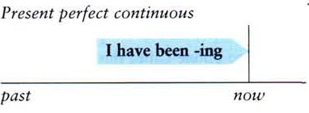
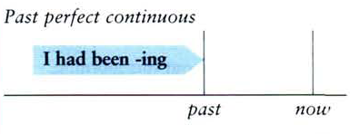
Had been ~ing (past perfect progressive) is the past of have been ~ing (present perfect progressive).
Compare:
present perfect progressive
I hope the bus comes soon. I've been waiting for 20
minutes. (before now)
He's out of breath. He has been running.
past perfect progressive
At last the bus came. I'd been waiting for 20 minutes.
(before the bus came)
He was out of breath. He had been running.

Slide 10
Use the present perfect progressive and past perfect progressive.
1- We (wait) ………………………. for Nancy for the last two hours, but she still hasn’t arrived.
2-We (wait) ………………………. for Nancy for over three hours before she finally arrived yesterday.
3-It is midnight. I(study)…………………………..for five straight hours. No wonder I’m getting tired.
4- It was midnight. I (study) ……………………………….. for five straight hours. No wonder I was getting tired.
have been waiting
had been waiting
have been studying
had been studying

Slide 11
Compare had been doing and was doing (past progressive):
It wasn't raining when we went out. The sun was shining. But it had been raining, so the ground was wet.
Ann was sitting in an armchair watching television. She was tired because she'd been working very hard.

Slide 12
Some verbs (for example, know and
want) are not normally used in the
progressive:
We were good friends. We had known each other for years.
(NOT 'had been knowing')

Slide 13
It is important to remember that Non-Continuous Verbs cannot be used in any continuous tenses.
Instead of using Past Perfect Continuous with these verbs, you must use Past Perfect.
Examples:
The motorcycle had been belonging to George for years before Tina bought it.
The motorcycle had belonged to George for years before Tina bought it.
Not Correct
Correct

Slide 14
Exercise
Read the situations and write sentences from the words
in brackets:
1. I was very tired when I arrived home. (I/work/hard all day)
I had been working hard all day.
2. The two boys came into the house. They had a football and they were both very tired. (they/play/football)
They had been playing football
3. Ann woke up in the middle of the night. She was frightened and didn't know where she was. (she/dream)
She had been dreaming.

Slide 15
Put the verb into the most suitable form, past progressive (I was doing), past perfect (I had done) or past perfect progressive (I had been doing).
Exercise
1-It was very noisy next door. Our neighbors ……………….. (have) a party.
2. We were good friends. We…………………... (know) each other for a long time.
3. John and I went for a walk. I had difficulty keeping up with him because he……………..... (walk) so fast.
4. Mary was sitting on the ground. She was out of breath. She …………………………(run)
were having
had known
was walking
had been running

